Slide 1
Realism
1855 – 1914

Slide 2
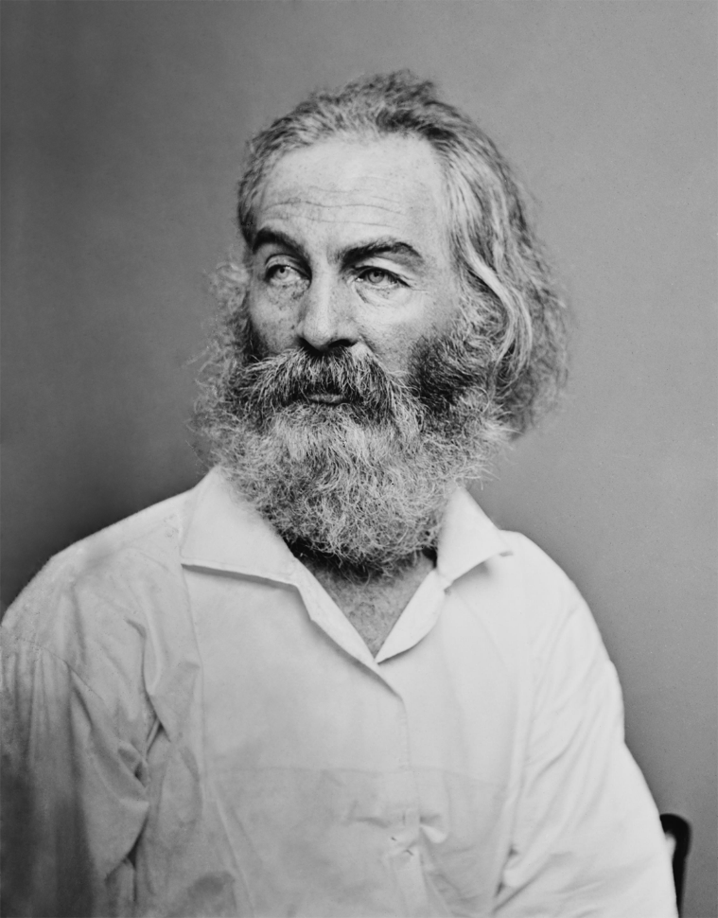
The Civil War: Changed Everything
A nation divided
Interrupts Transcendentalism
Walt Whitman
Transition Writer; late Transcendentalist poet, early Realist
Leaves of Grass
“O Captain, My Captain” – written upon Lincoln’s death

Slide 3
Historical Background
Population of US is growing rapidly
Science, industry, and transportation are expanding
The aftermath of the Civil War meant that Americans were less certain and optimistic about the future
The idealism of the Romantic period and philosophy of the Transcendentalists seemed out of date and irrelevant to many readers

Slide 4
Realism
The writing of this period steered away from the Romantic, highly imaginative fiction of the early 1800s
A reaction AGAINST Romanticism
Rejected heroes, adventurous or unfamiliar subjects
The harsh reality of frontier life and the Civil War shattered the nation’s idealism
The three main movements are:
Realism -- Regionalism
Naturalism

Slide 5
Realism
Purpose was “to instruct and entertain”
Character was more important than plot
Subject matter drawn from real life experience
Reject symbols and romanticizing of subjects
Settings are usually familiar to the author
Plots emphasized the “norm of daily experience”
Ordinary characters

Slide 6
Some Writers from Realism Period
Jack London
The Call of the Wild
White Fang
Kate Chopin
The Awakening
Story of an Hour
Mark Twain
Adventures of Huckleberry Finn
Adventures of Tom Sawyer
Life on the Mississippi
Stephen Crane
The Red Badge of Courage
Willa Cather
My Antonia
O Pioneers!
Bret Harte
Outcasts of Poker Flats

Slide 7
Literary Style and Concerns
Uniformity & diversity – objective writing about ordinary characters in ordinary situations; “real life”
“The art of depicting nature as it is seen by toads…” –Ambrose Bierce
Capturing the commonplace
Writing in vernacular
Local stories
Nature again
Yes, it is beautiful…but it is also hard and brings hardship and can wear the human spirit down

Slide 8
Realism - Characteristics
Character is more important than action or plot; complex ethical choices are often the subject
Characters appear in their real complexity of temperament and motive
Class is important; the novel has traditionally served the interests and aspirations of the insurgent middle class
Diction is naturally vernacular, not heightened or poetic; tone may be comic, satiric, or matter-of-fact

Slide 9
Regionalism
Regionalism is all about “local color” or “local flavor”
“Local Color” means a reliance on minor details and dialects
They usually wrote about the South or the West
More often than not, these stories were full of humor and small-town characters

Slide 10
Naturalism
Themes
Survival (man v nature, man v self)
Determinism (nature is an indifferent force on the lives of humans)
Violence
Depicting life as it is – with the understanding that humans have no real control over anything; believed larger forces were at work: Nature, Fate, and Heredity
More pessimistic than Realism
Writing inspired by hardships, whether it was war, frontier, or urbanization

Slide 11
Naturalism - Characteristics
Characters
Usually un-educated or lower class
Lives governed by the forces of heredity, instinct, passion, or the environment
The criminal, the fallen, the down-and-out

